Slide 1

Robotic Process Automation
Market Research

Slide 2



Research Objectives
Operation Way of RPA tools
Their Features
Applications in Financial Industry

Slide 3
Financial Demand on RPA
Days Sales Outstanding depends on the human element on both the payee’s and the recipient’s side.
For example, an accountant can forget to send an invoice. This leads to not only a cash gap - it jeopardizes the order to cash process and impacts liquidity if it occurs more frequently.
RPA to rescue: bots can solve problems of human employee such as oblivion, bad health, etc. This results in a consistent cash flow without deficiencies. Apart from that, RPA helps in:
Customer data setup and management
Extracting customer information from different sources
Sales quotation and entry generation
Invoice generation and distribution
Cash application
Customer credit monitoring
Dispute resolution
Follow-ups, reminders, and dunning
Credit risk management
Chargeback
Use case 01
Accounts Receivable

Slide 4
Financial Demand on RPA
A high Days Payable Outstanding is good when it’s triggered by friendly credit terms, and not so good if the reason is that you are not able to pay your bills on time due to inefficiency.
Operational lags in accounts payable usually occur while processing invoices. Vendor invoices are non-standardized, and need to be cross-checked with purchasing orders and approved.
RPA solution: Intelligent automation can streamline this process end-to-end even if the incoming docs are paper-based, thanks to optical character recognition technology (OCR). Software robots can direct invoices to the team member responsible for their approval and set up reminders. They can also match the purchase order with the invoice, compare them, and flag the mismatches (if any) for review.
Use case 02
Accounts Payable
and procure to pay

Slide 5
Financial Demand on RPA
Balancing accounts to provide an accurate financial statement is a source of constant stress due to manual data entry, extraction, and cross-checking. In the worst cases, identifying unrecorded transactions or balances and rooting out invoicing mistakes can paralyze the entire department.
RPA bots’ help: can streamline this process by easily acquiring and checking transactional data from any source, automatically approving all matching records, and notifying about discrepancies.
Use case 03
Intercompany
reconciliations (ICR)

Slide 6
Financial Demand on RPA
Businesses need to be in the know about inventory levels to maintain a constant product supply.
RPA bots can do all the heavy lifting and help leverage the dead stock and stock-outs, improve lead times, and optimize storage costs. Moreover, these are tasks that a bot can handle without a supervisor :
Monitoring inventory
Notifying about low inventory levels
Ordering products when the stock levels hit a threshold
Placing and approving stock orders
Forecasting optimal inventory levels
Updating ERP and WMS systems
Reporting and follow-ups
Tracking shipments
Use case 04
Inventory management

Slide 7
Financial Demand on RPA
RPA bots can facilitate lots of manual work for both travelers and accountants, creating a better employee experience. They can extract and read data from all types of receipts, check whether they qualify as a business expense, and wrap them into accurate expense reports—and all this with zero time spent on the part of the employees involved. And :
Entering expense records and checking according to company policies and legislation
Aggregating data into expense reports
Creating paychecks and managing benefits and reimbursements
Alerting in case of policy violations or data discrepancies
Use case 05
Travel & expenses

Slide 8
Financial Demand on RPA
Updating P&L reports manually is tedious and time-consuming.
RPA can take this task off your shoulders and generate immaculate reports in real time. Such intelligent automation will make your business processes more transparent and ensure financial forecasting accuracy. There are quite a lot of reporting processes where RPA can come handy:
Trial balance and balance sheets
Income statements
P&L
Variance analysis
Financial close processes
Regulatory/management reports
Use case 06
Financial reporting

Slide 9
RPA market share & competitors
- Dự đoán RPA đang đáng giá bao nhiêu?
- Công ty nào đang cung cấp RPA software (ở Việt Nam) và cung cấp như nào (outsource / product) ? Fsoft,

Slide 10


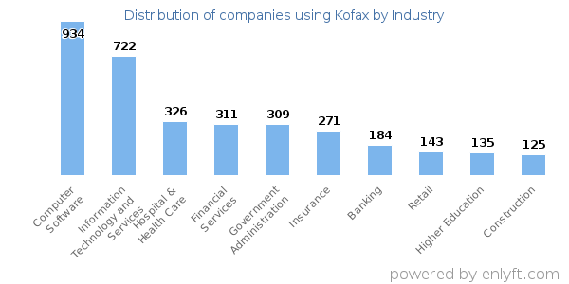
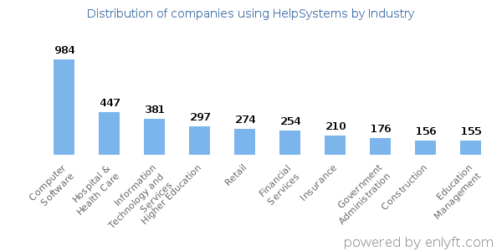
RPA tools - Overview
Computer Software (16%), Information Technology and Services (12%), Hospital & Health Care (6%), Financial Services (5%) and Government Administration (5%) are the largest segments.
Computer Software (14%), Hospital & Health Care (6%) and Information Technology and Services (5%) are the largest segments.
Src: https://enlyft.com/

Slide 11


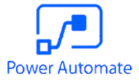
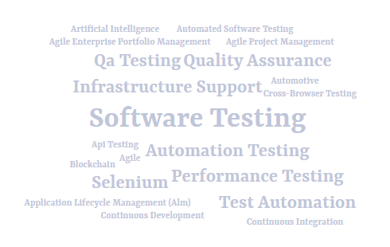
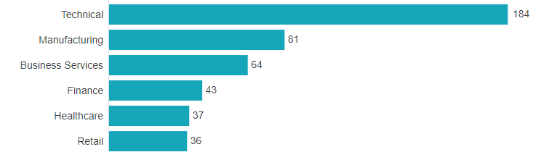
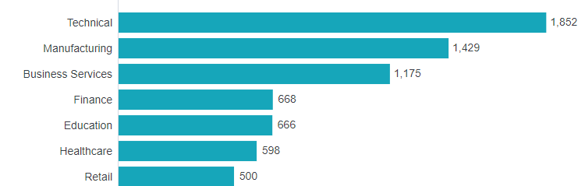
RPA tools - Overview
“The eggPlant testing tool provides developers and testers with software to create, schedule and execute automated testing and debugging tasks on a variety of mobile platforms.”
Similar as EggPlant, Power Automate is mostly applicated in Technical and Manufacturing.
Most of Zaptest’s customers focus on Software testing

Slide 12



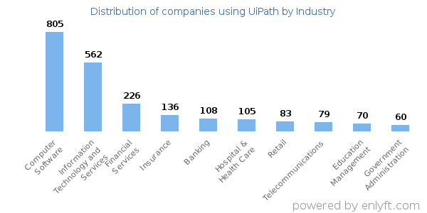
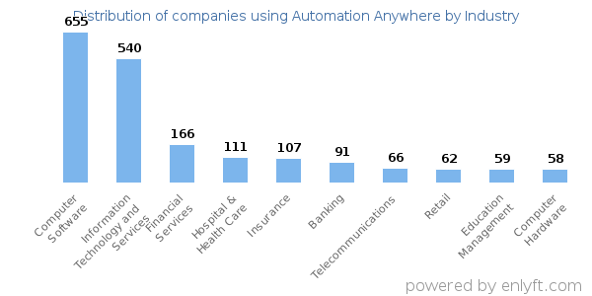
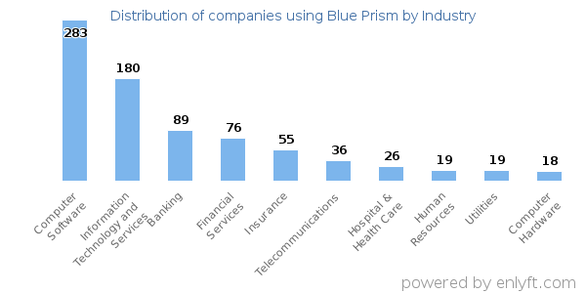
RPA tools - Overview
Computer Software (22%), Information Technology and Services (15%) and Financial Services (6%) are the largest segments.
Computer Software (21%), Information Technology and Services (17%) and Financial Services (5%) are the largest segments.
Computer Software (24%), Information Technology and Services (15%), Banking (7%) and Financial Services (6%) are the largest segments.
Src: https://enlyft.com/

Slide 13
Research Scope
Because of attaching importance into Financial Industry, we only dive deeper into tools much more used by finance companies.

Slide 14
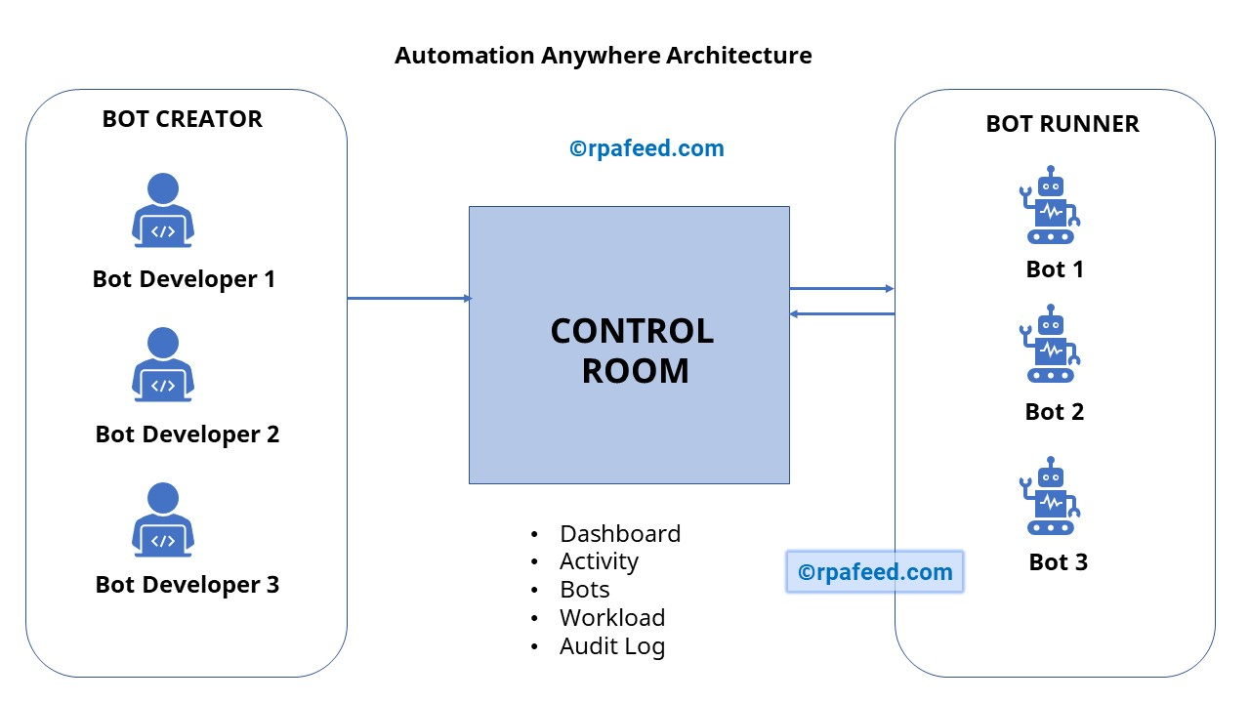
Architecture
Control Room: the Server that controls Automation Anywhere bots
Bot Creator: Where to create/edit bots (dev license required)
Bot Runner: Where to run built bots (run license required)
Src: https://rpafeed.com/

Slide 15
















Features
Task Editor
Workflow Designer
Report Designer
Trigger Manager
Workload management
Recorders
Image Recognition & OCR

Slide 16


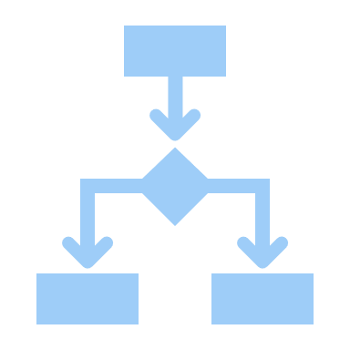



Automated-support processes
Data extraction and submission
All windows and web-based user actions
Rule-based decisions
Data comparison and validation
Navigation through web, windows, cloud, legacy systems

Slide 17

Applications in Financial/banking/accounting industries
Invoice processing
Data Entry
Data Validation
Data Migration
Reporting
Auditing
Customer account Management
Form Filling
Claim processing

Slide 18
Weakpoints
Automation Anywhere chưa hổ trợ được những công việc như nào???

Slide 19
Operation
Cách thức vận hành, môi trường làm việc??

Slide 20







Features
Email automation
Scrap data
Worksheet, workbook, pdf processing
Download/upload files
CAPTCHA automation

Slide 21

Weakpoints
Image processing
Physical forms
Barcode reader
Voice commands

Slide 22















Features
Virtual workforce
Complete Automation
Robust features
Spying modes
Configurable dashboard
{ }
Multi-platform support
Codeless
Excel, xml, csv, pdf, image
Exception stages
MS Azure & Amazon AWS cloud support

Slide 23


Components
Blue Prism is a set of libraries, tools, and runtime environments for RPA.
Every software robot has two main parts:
Process studio
Object studio

Slide 24
Weakpoints
Blueprism chưa hổ trợ được gì???

Slide 25
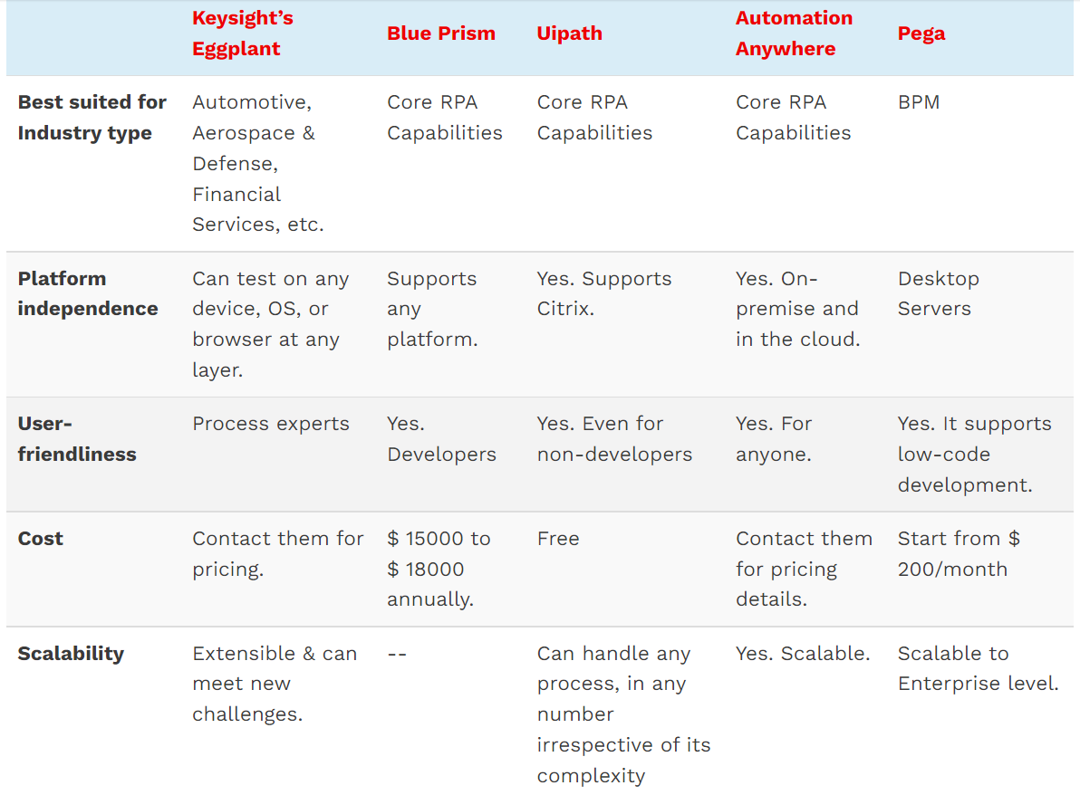
Summary
Làm lại !!!

Slide 26
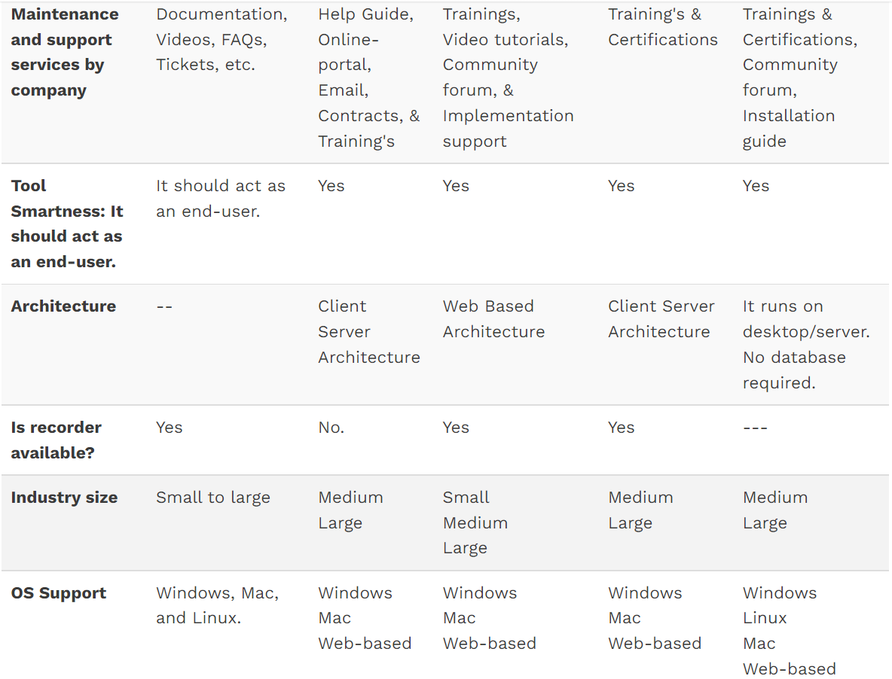
Summary

Slide 27
Thank you

